Slide 1
Advanced Javascript
Day 3 - Js Prototypes, Inheritance

Slide 2
Our goal today is, understanding what prototype means in a real world and then connecting that knowledge with how Js works.

Slide 3

What is a Prototype?
An original model on which something is patterned.

Slide 4
Lets create a simple object and see what a prototype is in Js.
var objectA = {}

Slide 5
Lets create a simple object using another object and see what a prototype is in Js.
var objectB = Object.create(objectA)

Slide 6

[[Prototype]]?
Points to original model (prototype) from which it is built from.
👈

Slide 7

In Js, a prototype can also have a prototype hence creating a prototype chain.
👈
👈

Slide 8
In Js, it’s better to borrow, than own a property or method.

Slide 9
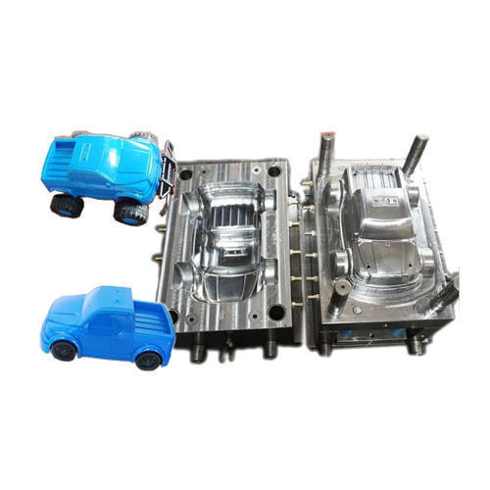
Using Prototype we can create a blueprint from which we can borrow.

Slide 10
What is an Inheritance?
One object gets access to properties and methods of other object.
Js has Prototypal Inheritance.

Slide 11
We can use Js Prototypal inheritance in two ways:
Function Constructors
Person.prototype.showName=function () {
console.log( this.name )
}
2. Object.create() method
var a = Object.create(b)

Slide 12
hasOwnProperty()
The hasOwnProperty() method in JavaScript is used to check whether the object has the specified property as its own property.
This is useful for checking if the object has inherited the property rather than being it’s own.
object.hasOwnProperty( prop )

Slide 13
Everything in Js is an Object!

Slide 14
What that means is, Js has an object as its base prototype. From that, it creates other data types and methods that we can use on them.
It’s just how Js was decided to be built.

Slide 15
Objects
var o = {a: 1};
The newly created object o has Object.prototype as its Prototype
So o inherits hasOwnProperty from Object.prototype
Object.prototype has null as its prototype.
o ---> Object.prototype ---> null

Slide 16
functions
function bark() {
return 2;
}
Functions inherit from Function.prototype
(which has methods call, bind, etc.)
f ---> Function ---> Object ---> null

Slide 17
Array
var cities = ['Pune', 'Mumbai', 'Delhi'];
Arrays inherit from Array.prototype
(which has methods indexOf, length, push etc.)
The prototype chain looks like:
b ---> Array.prototype ---> Object.prototype ---> null

Slide 18
Let’s Recap

Slide 19
Prototype -

Slide 20

Inheritance

